Slide 1
SELENIUM – CSS SELECTORS AND XPATH
Presented by : Maivizhi R

Slide 2
INTRODUCTION
Selenium
Selenium is an open-source automation testing tool.
Used to automate web applications.
Supports multiple browsers like Chrome, Firefox, Edge, and Safari.
Supports programming languages such as Java, Python, C#, and JavaScript.
Why do we need locators ?
Selenium cannot interact with elements without locating them.
Locators identify web elements like buttons, text boxes, links, checkboxes, and dropdowns.

Slide 3
TYPES OF SELENIUM LOCATORS
Selenium Locators :
ID
Name
Class Name
Tag Name
Link Text
Partial Link Text
CSS Selector
XPath
Explanation :
"Among all these locators, CSS Selector and XPath are the most commonly used because they help identify dynamic web elements."

Slide 4
CSS SELECTOR
Definition :
CSS Selector is a locator that identifies HTML elements using CSS syntax.
Advantages :
Faster than XPath.
Easy to write.
Less complex.
Better performance.
Syntax
tagname[attribute='value']
Example
input[id='username']
Explanation
"CSS Selector uses HTML attributes to locate elements. It is widely preferred because it executes faster than XPath."

Slide 5
TYPES OF CSS SLECTORS
1.By ID
#username
2.By Class
.login
3.By Attribute
input[type='text’]
4.Multiple Attributes
input[type='text'][name='username']
Explanation :
"CSS Selectors can identify elements using IDs, classes, attributes, or combinations of attributes."

Slide 6
XPATH
Definition :
XPath stands for XML Path Language.
It is used to locate elements in HTML or XML documents.
Advantages :
More flexible.
Supports dynamic elements.
Can navigate parent and child relationships.
Explanation :
"XPath is useful when CSS Selector cannot uniquely identify an element."

Slide 7
XPATH FUNCTIONS :
contains()
//input[contains(@id,'user')]
starts-with()
//input[starts-with(@id,'user')]
text()
//button[text()='Login']
Explanation :
"XPath functions help identify dynamic elements when their attribute values change."

Slide 8
Advantages :
Short.
Flexible.
Mostly used in Selenium.
Disadvantages :
Long.
Easily breaks if the page structure changes.
Explanation :
"Relative XPath is preferred because it is easier to maintain and less affected by changes in the page layout.“

Slide 9
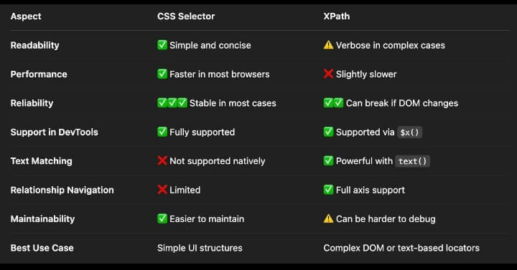

Slide 10
CSS Selector :
driver.findElement(By.cssSelector("#username")).sendKeys("Admin");
Xpath :
driver.findElement(By.xpath("//input[@id='password']")).sendKeys("admin123");
driver.findElement(By.xpath("//button[text()='Login']")).click();
CONCLUSION :
Selenium needs locators to identify web elements.
CSS Selector is fast and easy to use.
XPath is flexible and suitable for complex or dynamic elements.
Choosing the right locator improves automation efficiency.

